Slide 1
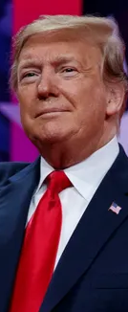
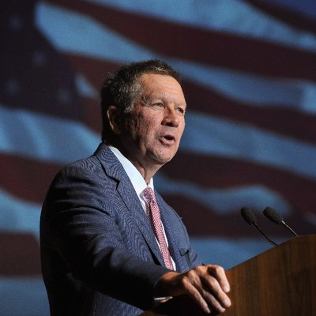
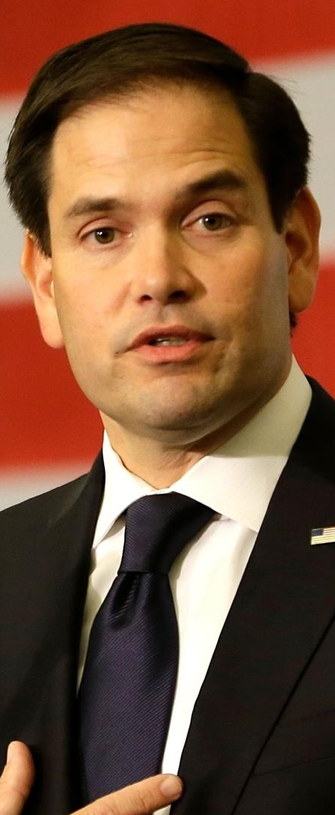
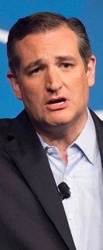
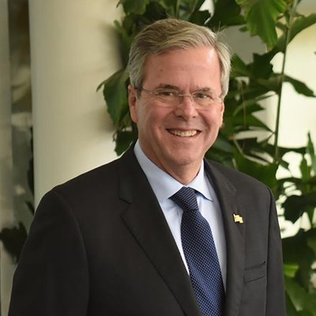
Republican
Candidate
Tweets
Louise Xu
Haonan Song
Yuchen Tang
Jared Leitner

Slide 2
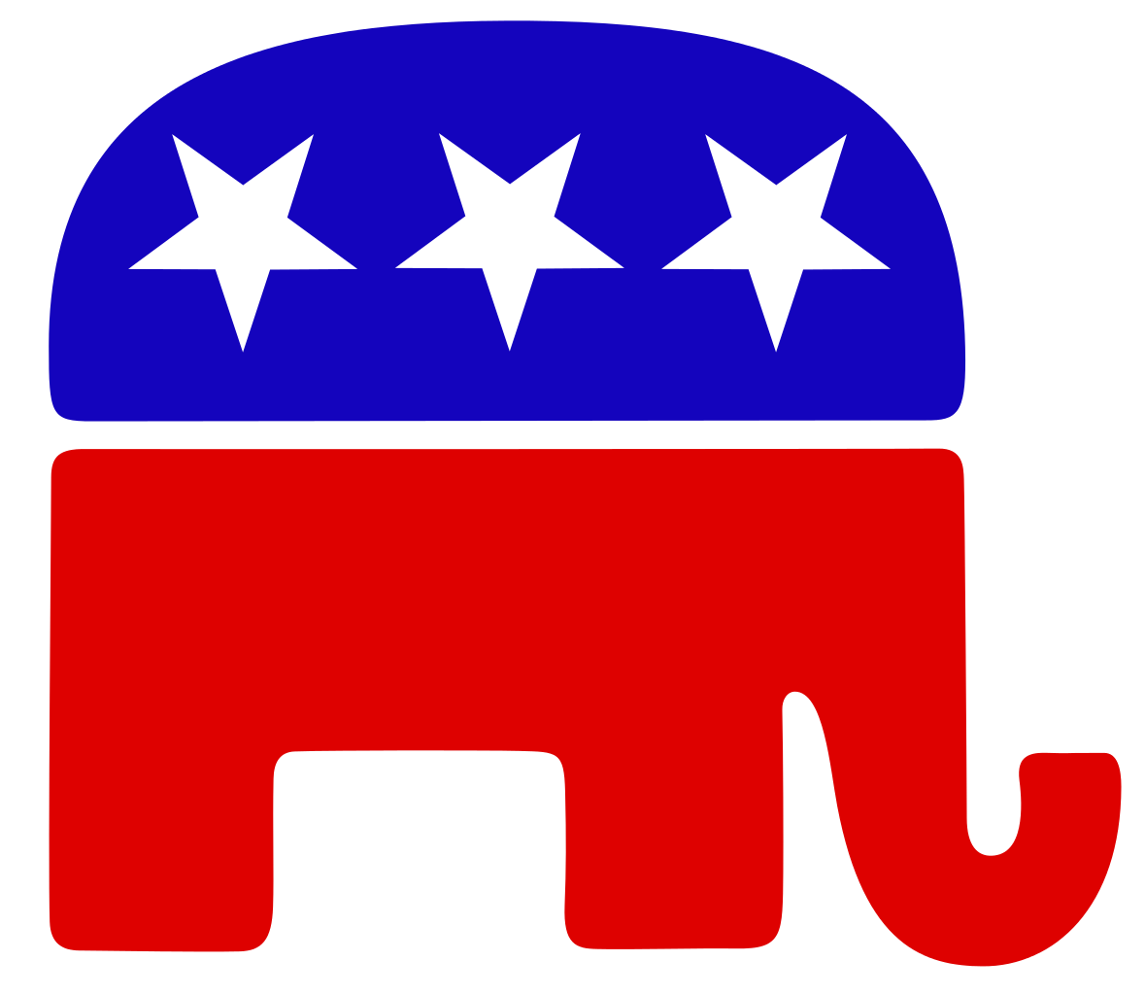
Objectives
Analyze tweets of top contenders in 2016 GOP primaries
Candidates:
Donald Trump
John Kasich
Marco Rubio
Ted Cruz
Jeb Bush
Tweet content vs. public response

Slide 3
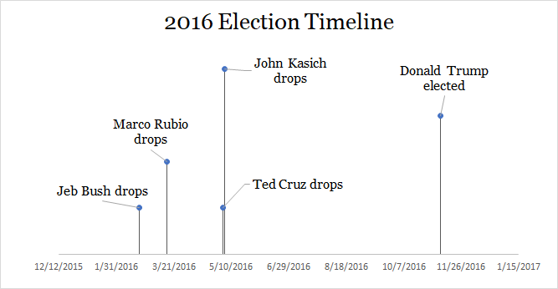
Timeline

Slide 4

Datasets
Tweets
Includes metadata (favorite count, retweet count, etc.)
Two methods for collecting tweets
Tweepy
Twitter API wrapper
Limited to last 3200 tweets
Requires authentication/developer account
GetOldTweets-Python
https://twitter.com/i/search/timeline
Uses “Advanced Search” feature on Twitter to retrieve tweets
[1] https://github.com/tweepy/tweepy
[2] https://github.com/Jefferson-Henrique/GetOldTweets-python

Slide 5
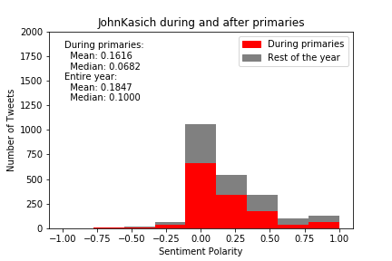
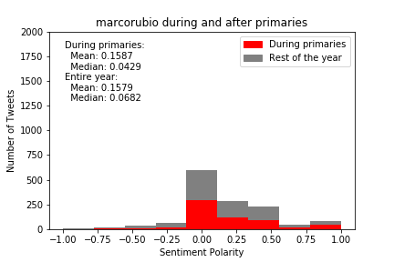
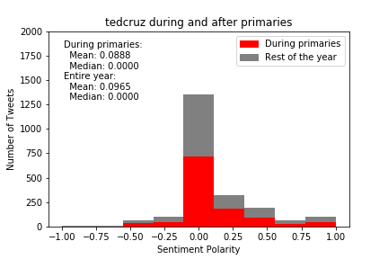
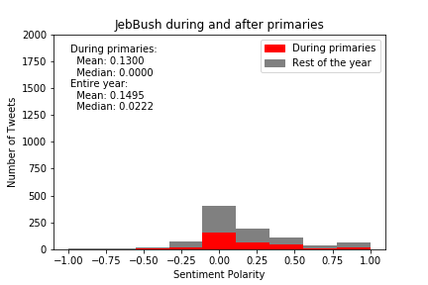
Metric Analysis

Slide 6
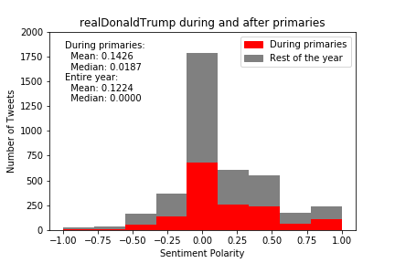
Metric Analysis

Slide 7
Average Sentiment Score
Trump - 0.122
Cruz - 0.096
Kasich - 0.184
Bush - 0.122
Rubio - 0.157

Slide 8
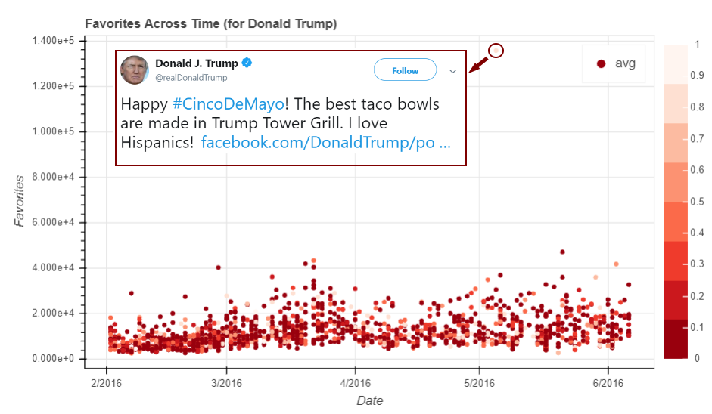
Metric Analysis
Sentiment: 0.767

Slide 9
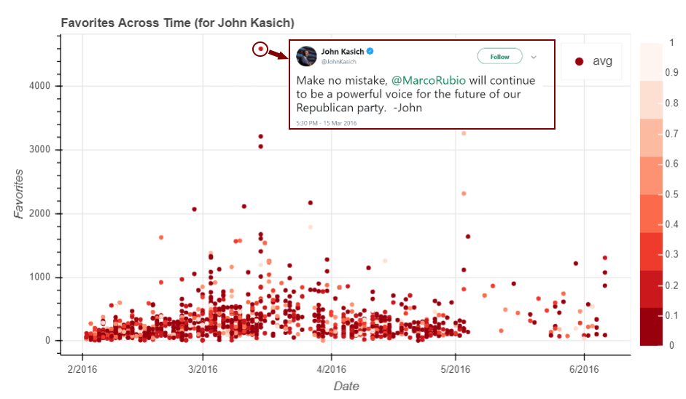
Metric Analysis
Sentiment: 0.150

Slide 10
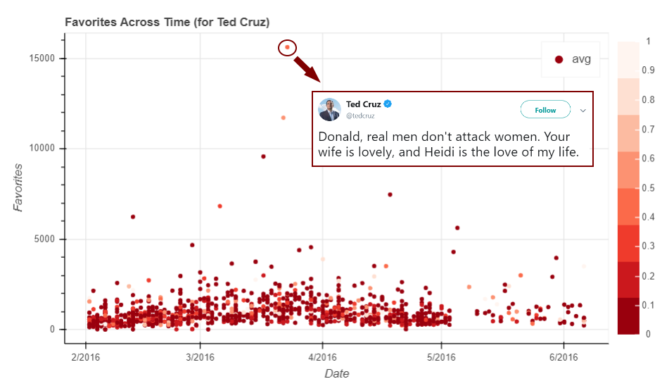
Metric Analysis
Sentiment: 0.400

Slide 11
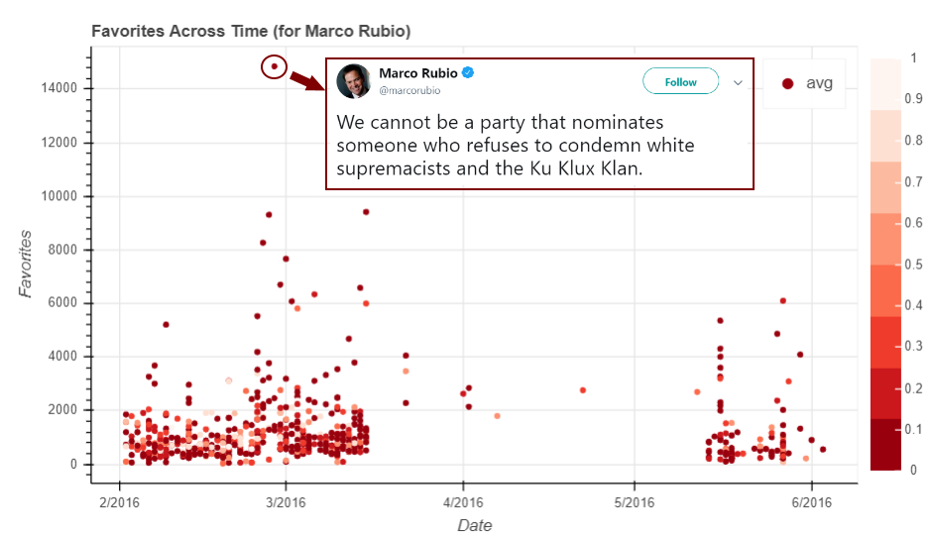
Metric Analysis
Sentiment: 0.000

Slide 12
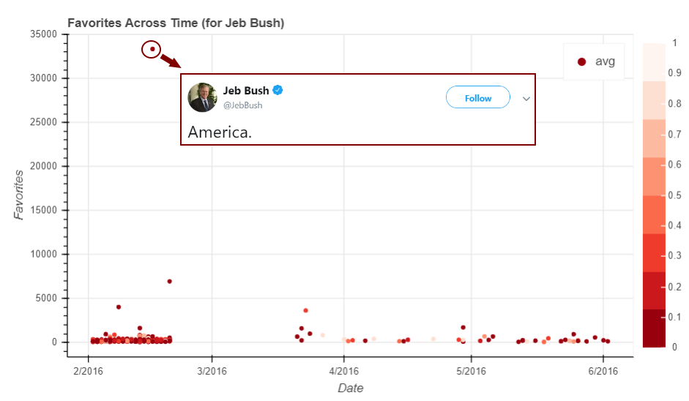
Metric Analysis
Sentiment: 0.000

Slide 13
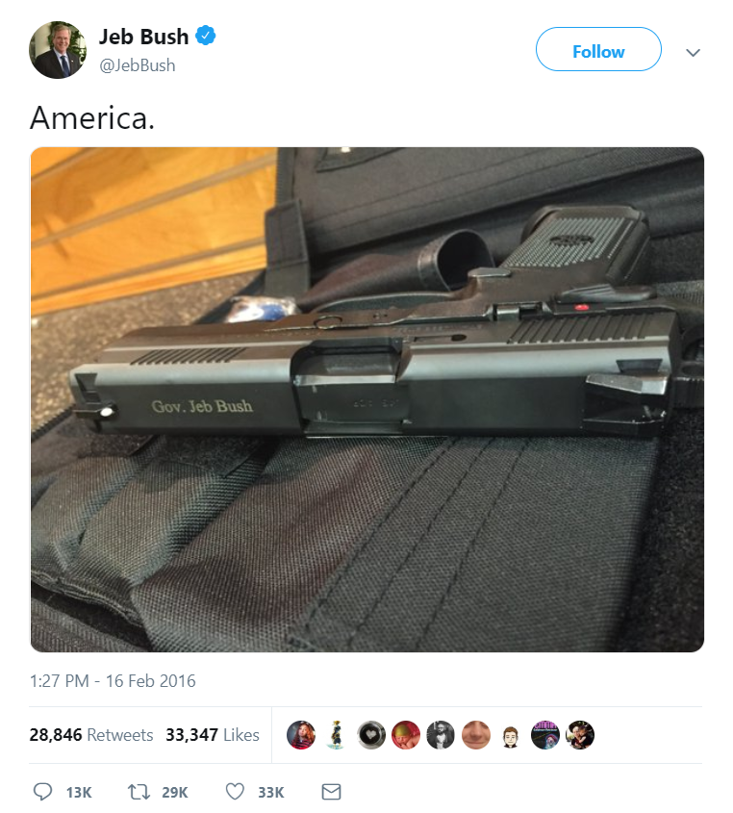
Metric Analysis

Slide 14
Discussion
We calculated the ratio of total favorite count to total retweet count of 434 US politicians and 5 Republican candidates.
If you retweet a tweet, it will appear in your profile and your follower will notice it, but if you “likes” a tweet, it will be harder for others to notice it. If I support Trump and do not want others know it, I would tend to use more “likes” instead of “retweet”. The higher the ratio is, the more people tend to hide their opinions.

Slide 15
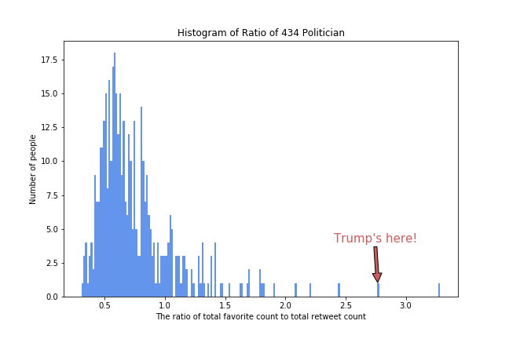
Ratio Analysis

Slide 16
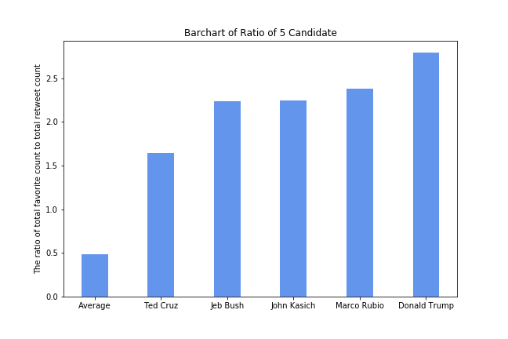
Ratio Analysis

Slide 17
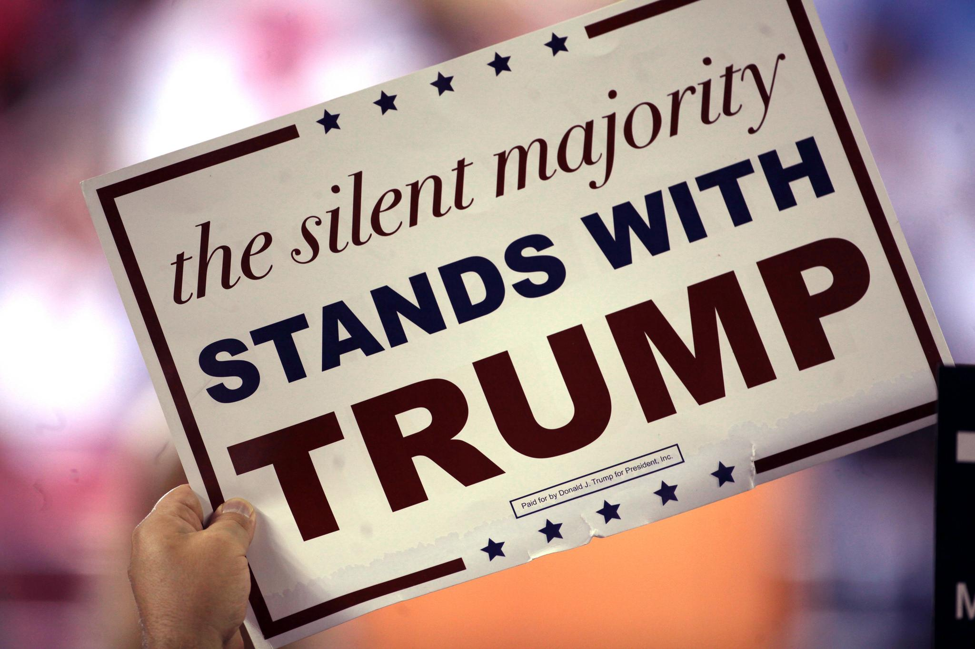
Silent Majority
People tend to hide their attitude towards famous politicians, so the ratio is much higher than average. Especially for Trump’s supporters, the ratio is the highest among all the Republican candidates.

Slide 18
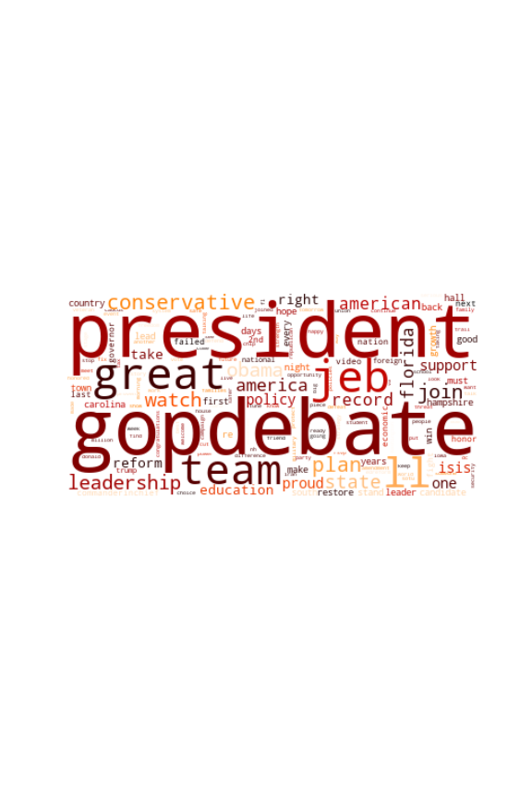
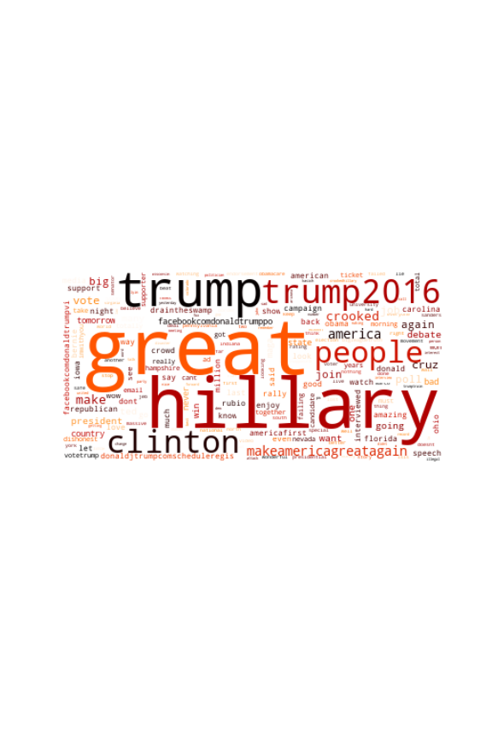
Word Clouds
Jeb Bush
Marco Rubio

Slide 19
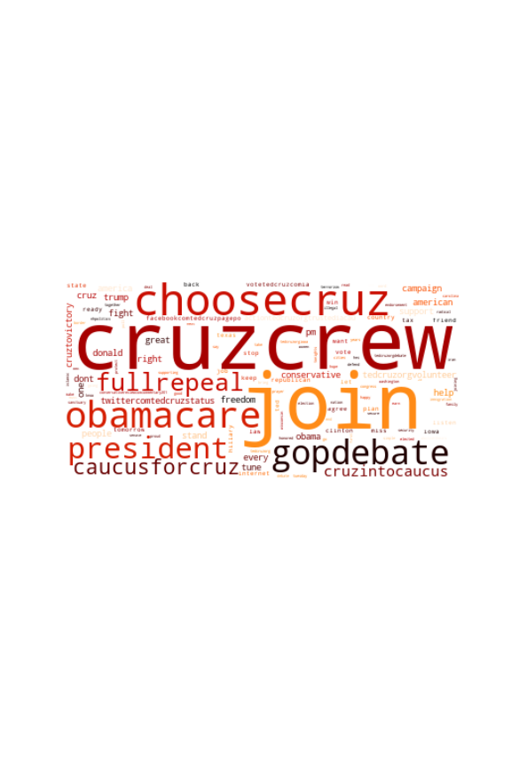
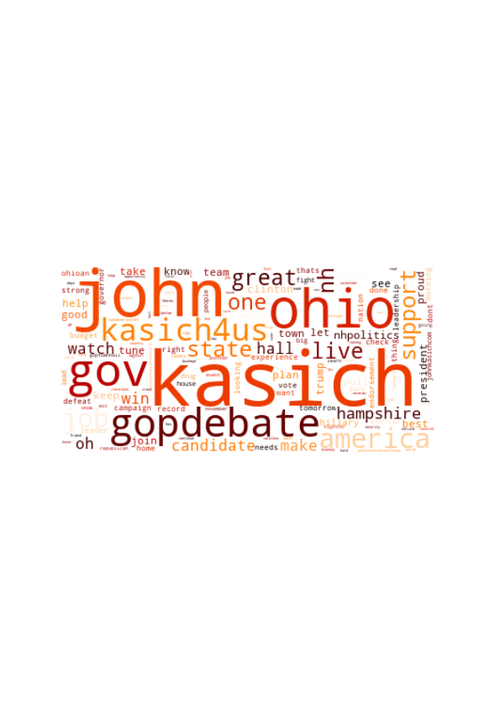
Word Clouds
Ted Cruz
John Kasich

Slide 20
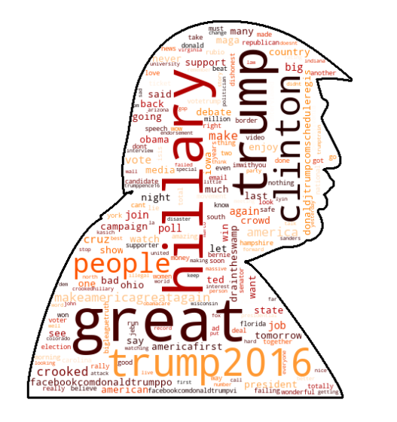
Word Clouds
Obama
“Drain the swamp”
Crooked

Slide 21
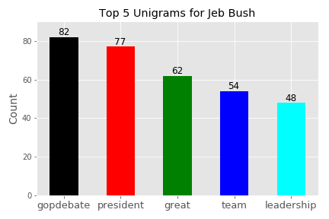
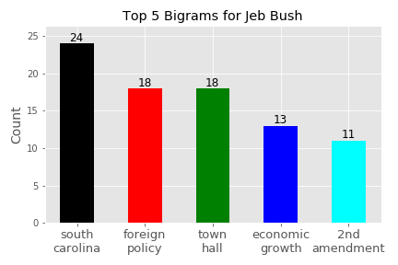
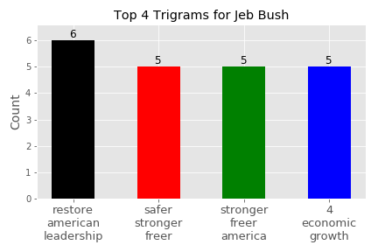
N-Grams: Bush
Team
Great

Slide 22
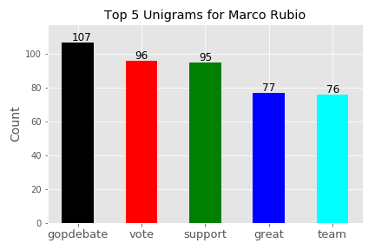
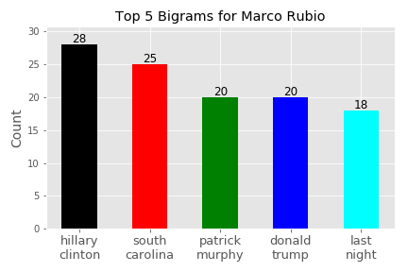
N-Grams: Rubio
Team
Great

Slide 23
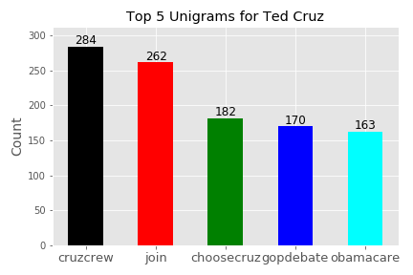
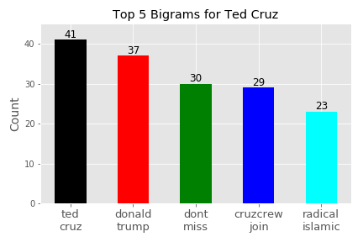
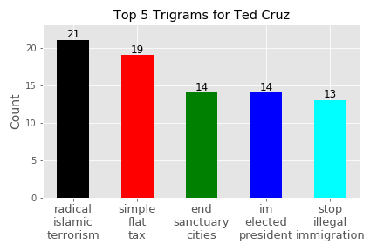
N-Grams: Cruz
Cruzcrew
Radical islamic terrorism

Slide 24
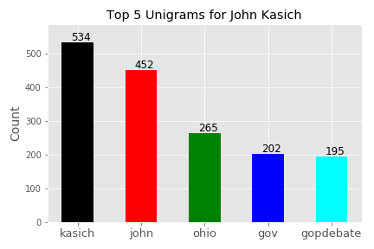
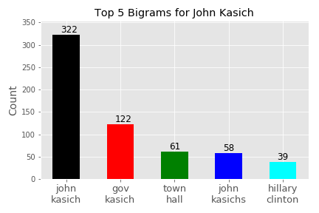
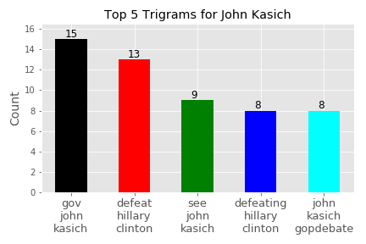
N-Grams: Kasich
Defeat Hillary Clinton

Slide 25
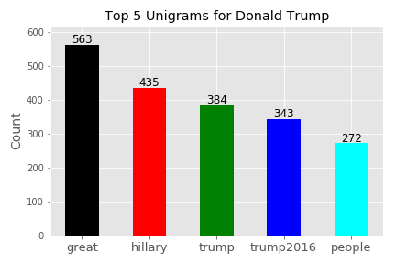
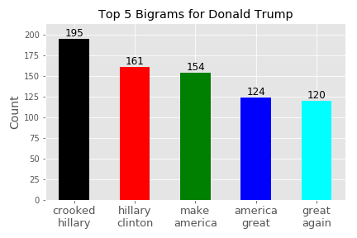
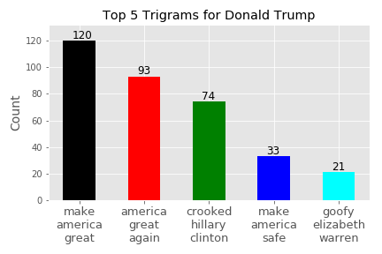
N-Grams: Trump
Crooked Hillary
Goofy Elizabeth Warren

Slide 26
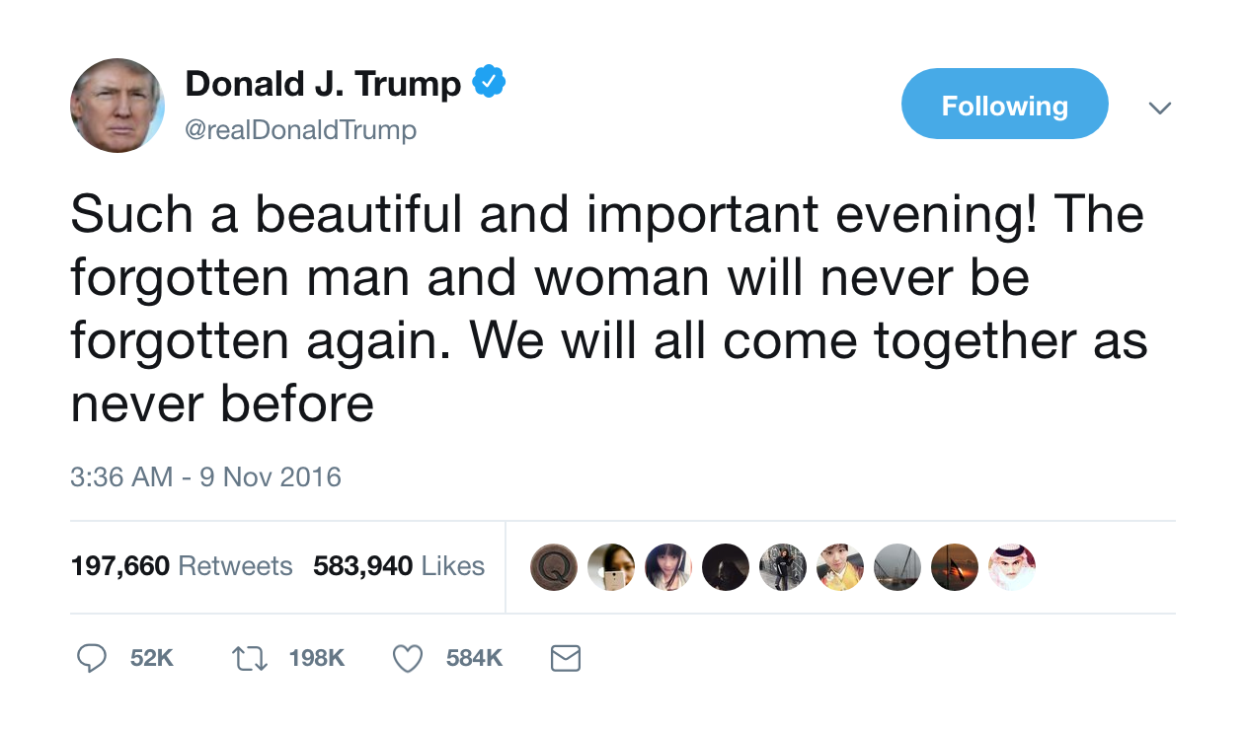
Most favorited and 2nd most retweeted from Trump
With sentiment polarity 0.42

Slide 27
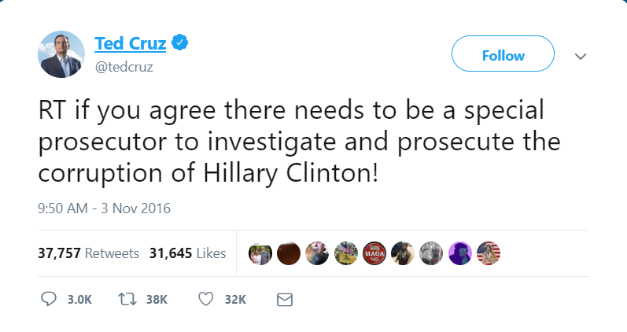
Most favorited and retweeted of Ted Cruz
With sentiment polarity 0.36

Slide 28
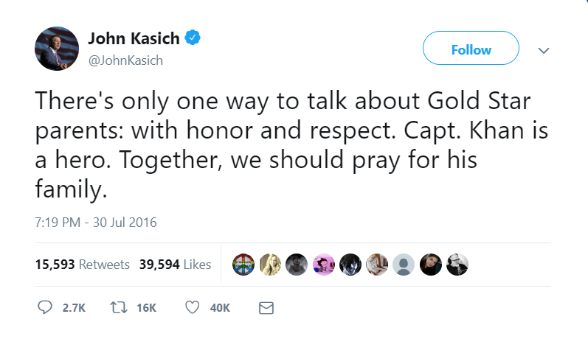
Most favorited and retweeted of John Kasich
With sentiment polarity 0.47

Slide 29
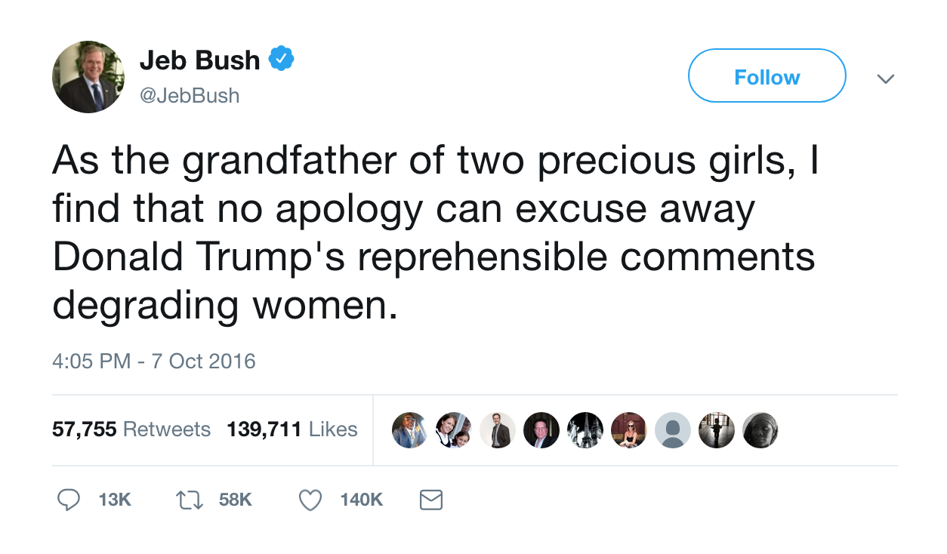
Most retweeted of Jeb Bush
With sentiment polarity 0.225

Slide 30
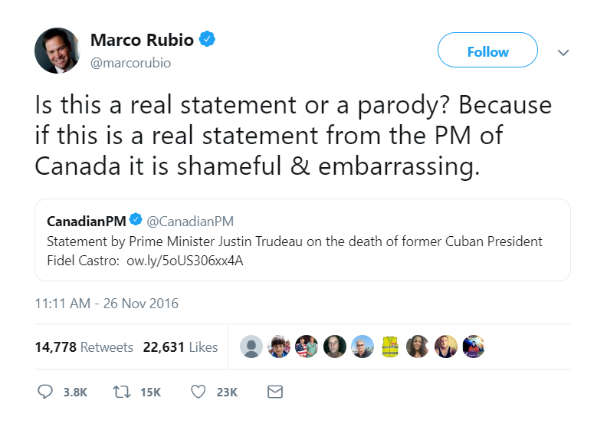
Most favorited and retweeted for Marco Rubio
With sentiment polarity 0.2

Slide 31
Conclusions
Bush and Rubio tweets contain dull content
Cruz, Kasich and Trump more emotionally charged
Stronger expression(higher sentiment polarity) → Better result
Frequency of posts DOES matter!

Slide 32
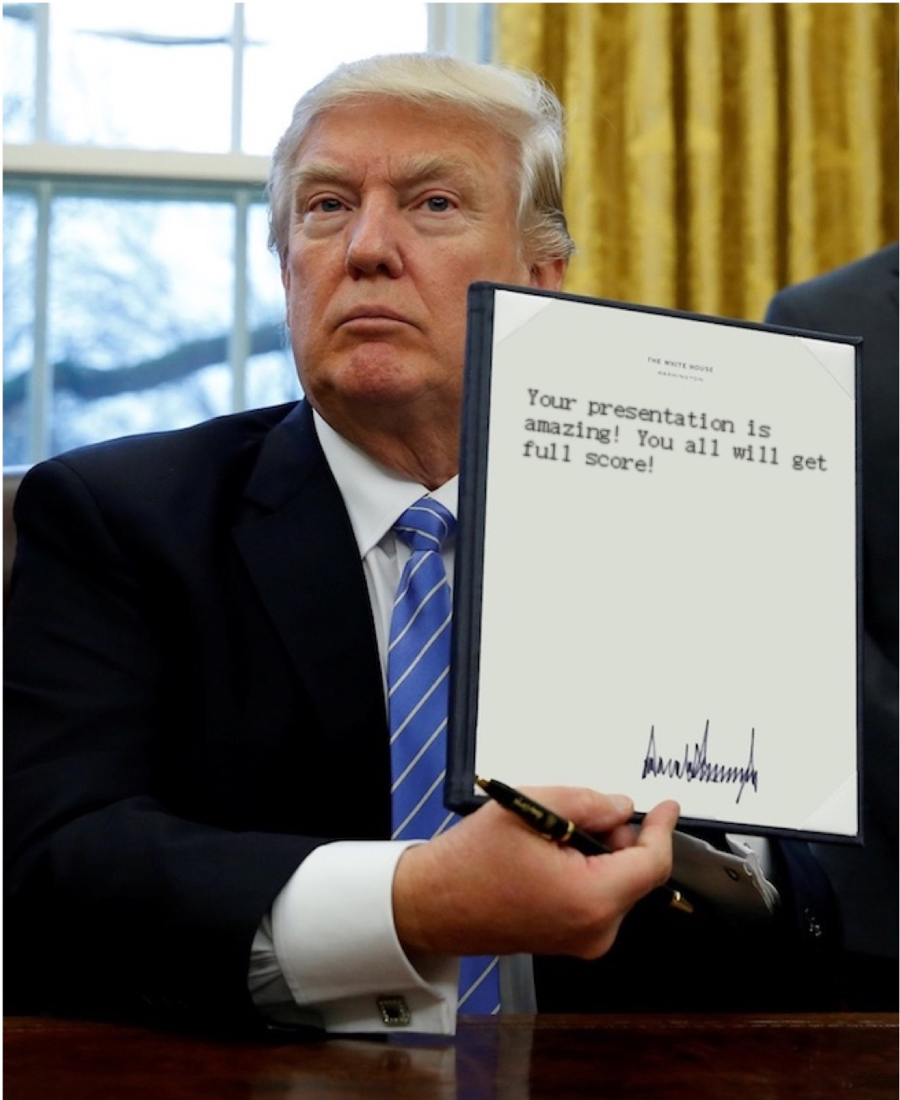
Breaking News!

